Slide 1
PROJECTREPORT 1.introduction
It sounds like you're looking for guidance on concluding the preparation and maintenance of Zoho Books for EduConnect Learning Centre. To wrap up this process, you should:1. *Review Data*: Double-check all the data entered into Zoho Books to ensure accuracy.2. *Generate Reports*: Generate any necessary financial reports or summaries for EduConnect Learning Centre.3. *Training*: If needed, provide training to EduConnect staff on how to use Zoho Books for their specific tasks.4. *Backup and Security*: Implement a backup and security plan to safeguard the data.5. *Feedback*: Gather feedback from EduConnect staff to address any concerns or make improvements.6. *Documentation*: Document any specific configurations or procedures for future reference.

Slide 2
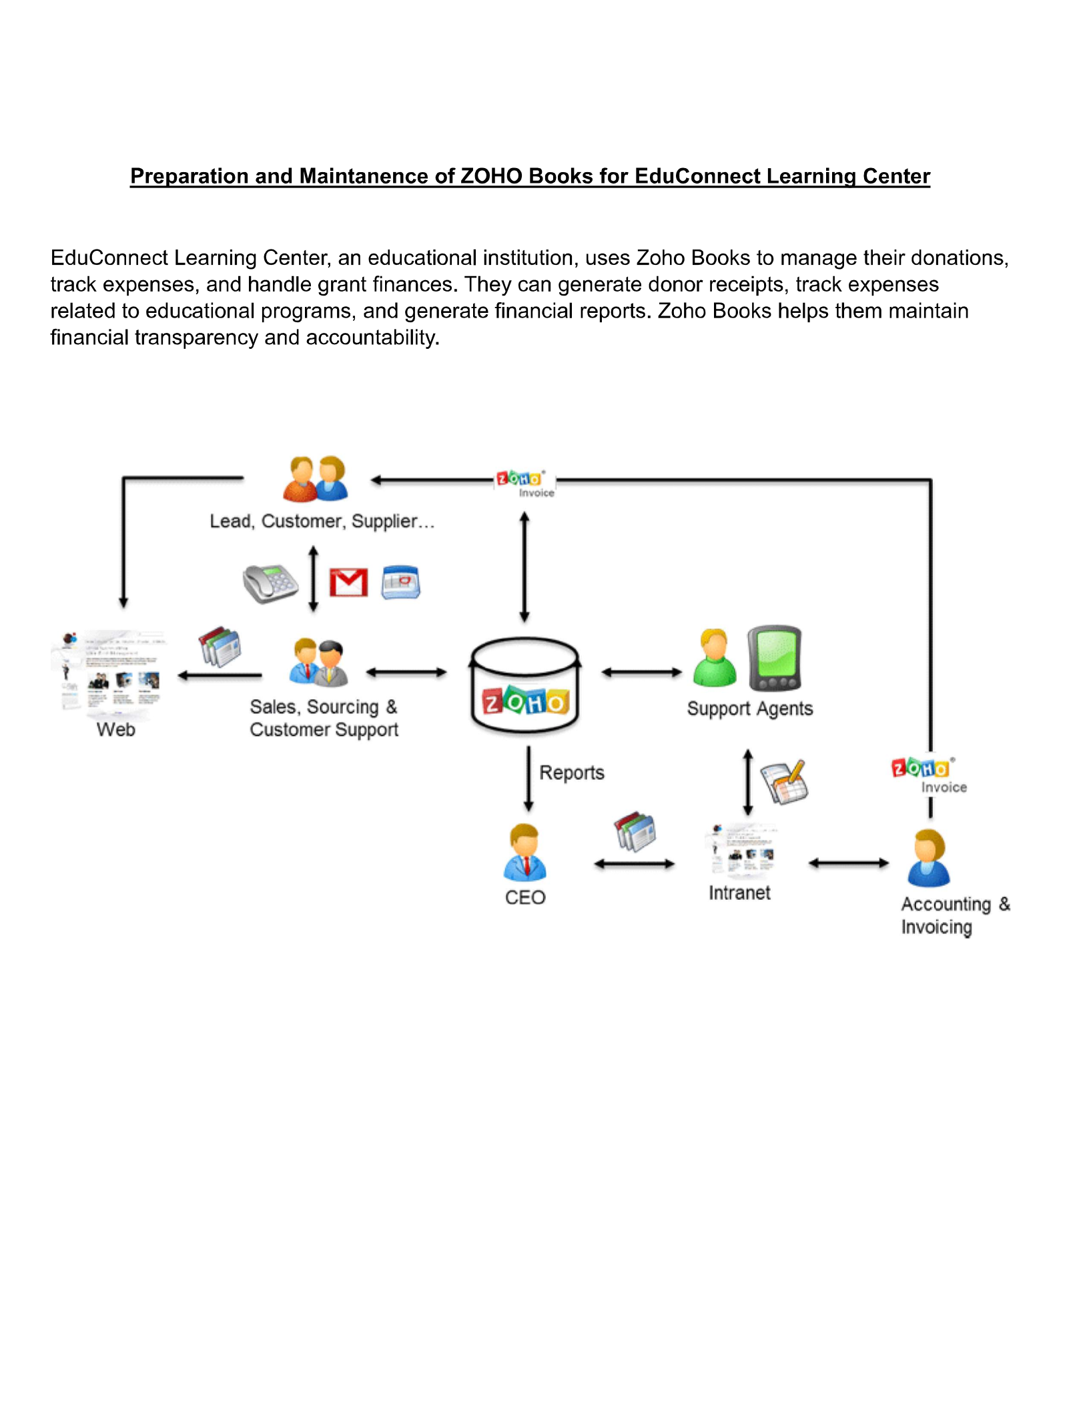
Preparation and maintance of zoho books educonnect learning centre

Slide 3
PROBLEM DEFINITION &DESIGN THINKING
It is created method of preparation of accounting profit and loss account,balancesheet and GST calculation is completed.
in recent days new technologies allotted.here we use zohobook as a tool for creating profit and loss account,balancesheet and GST report.
Empathy map
Ideation & brainstorming map

Slide 4
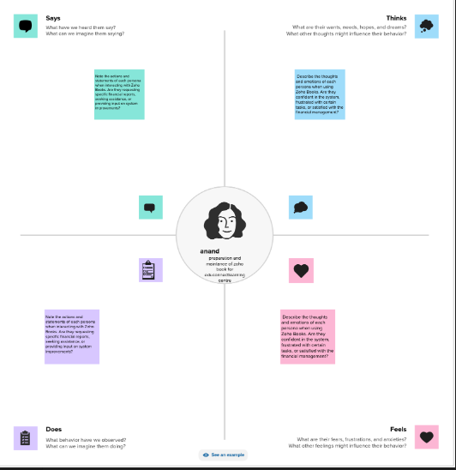
EMPATHY MAP

Slide 5
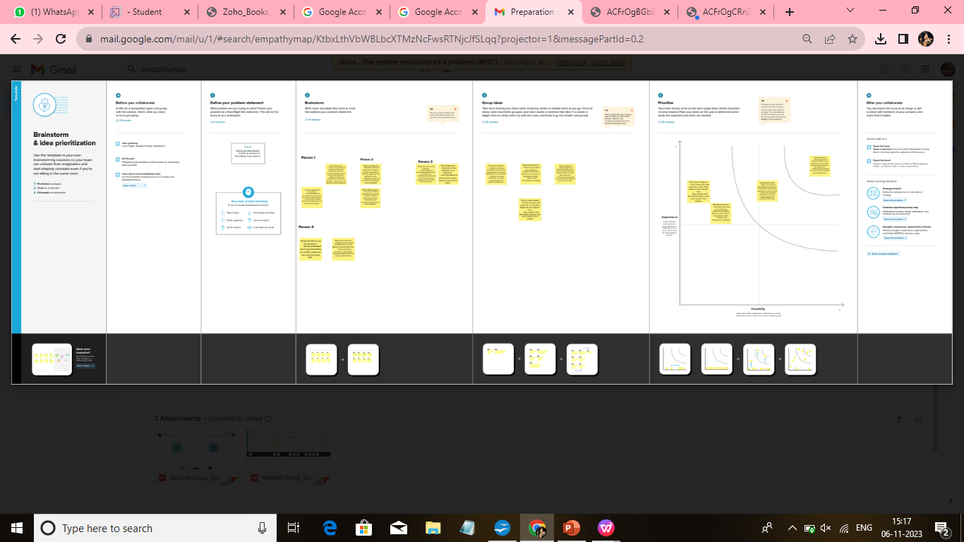
RESULT
Output:
Company name creation

Slide 6
We have to create our company name and other details from below zohobooks
Item creation:we have to create items,such as
Item names
Units
HSN/SAC
Selling info/purchase info
Tax rate

Slide 7
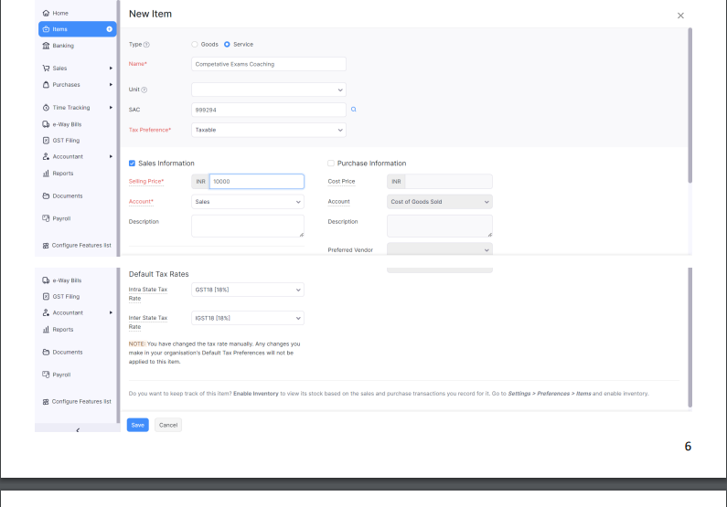
Item creation

Slide 8
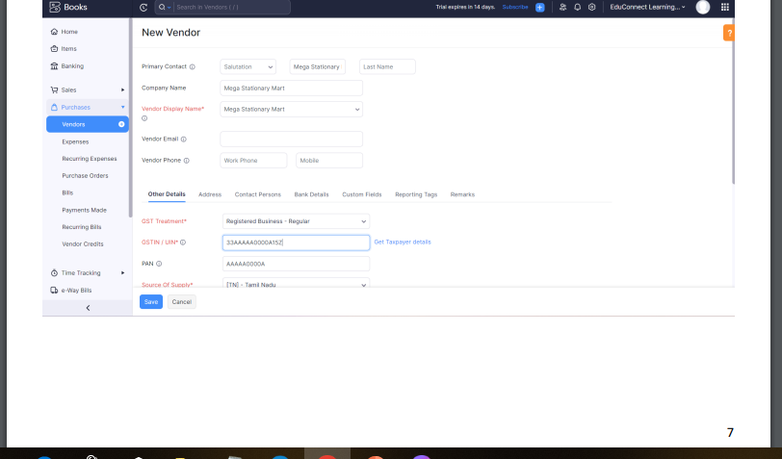
3.Vendor creation

Slide 9
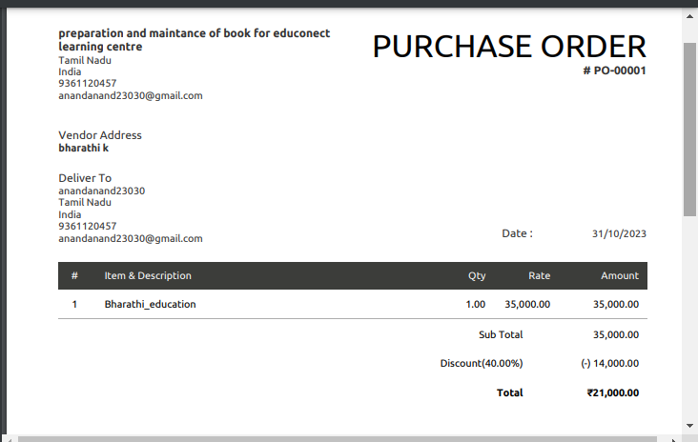
4.Purchase order
We are creating new purchase order such as below

Slide 10
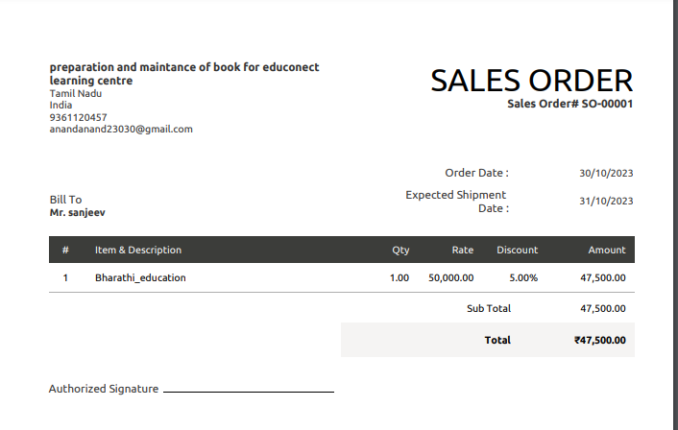
Sales order

Slide 11
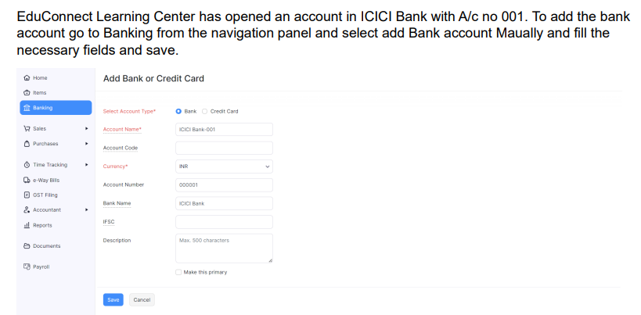
6.Payment to bank details:

Slide 12
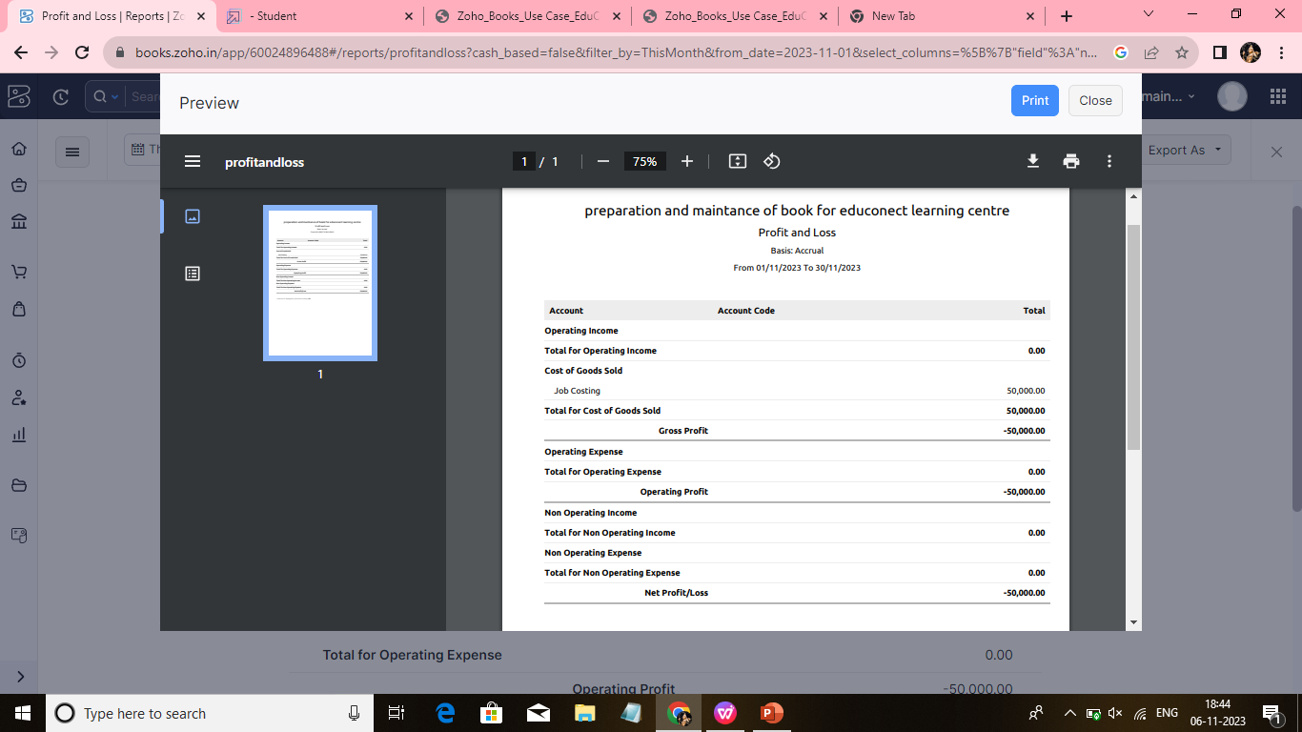
7.Profit and loss account \balancesheet\gst report:

Slide 13
4.ADVANTAGE &DISADVANTAGE:
Advantage:easy for managing day to day activities.
disadvantage:missing new version
5.APPLICATION:
this application used to maintain the company details and ledger accounts,profit and loss account and balancesheet of the preparation and maintenance of zoho books educonnect learning centre
6.CONCLUSION
It sounds like you're looking for guidance on concluding the preparation and maintenance of Zoho Books for EduConnect Learning Centre. To wrap up this process, you should:1. *Review Data*: Double-check all the data entered into Zoho Books to ensure accuracy.2. *Generate Reports*: Generate any necessary financial reports or summaries for EduConnect Learning Centre.3. *Training*: If needed, provide training to EduConnect staff on how to use Zoho Books for their specific tasks.4. *Backup and Security*: Implement a backup and security plan to safeguard the data.5. *Feedback*: Gather feedback from EduConnect staff to address any concerns or make improvements.6. *Documentation*: Document any specific configurations or procedures for future reference.

Slide 14
7.FUTURE SCOPE:
It sounds like you're looking for guidance on concluding the preparation and maintenance of Zoho Books for EduConnect Learning Centre. To wrap up this process, you should:1. *Review Data*: Double-check all the data entered into Zoho Books to ensure accuracy.2. *Generate Reports*: Generate any necessary financial reports or summaries for EduConnect Learning Centre.3. *Training*: If needed, provide training to EduConnect staff on how to use Zoho Books for their specific tasks.4. *Backup and Security*: Implement a backup and security plan to safeguard the data.5. *Feedback*: Gather feedback from EduConnect staff to address any concerns or make improvements.6. *Documentation*: Document any specific configurations or procedures for future reference.
8.APPENDIX:
Approved development
Future assessment
Plan of development
Development purpose
interpretation

